Slide 1

Git workshop Peter Rothman 2016-05-20

Slide 2
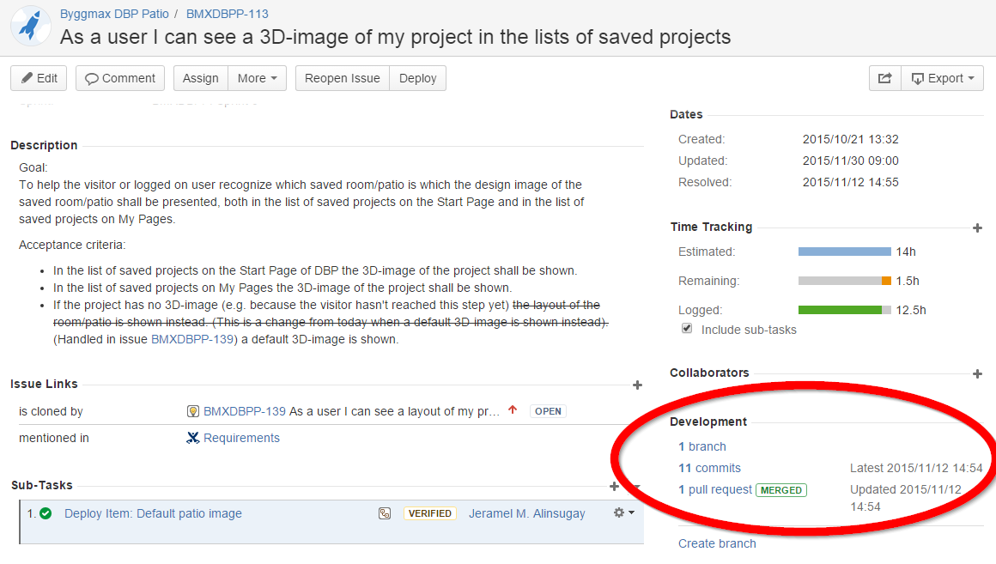
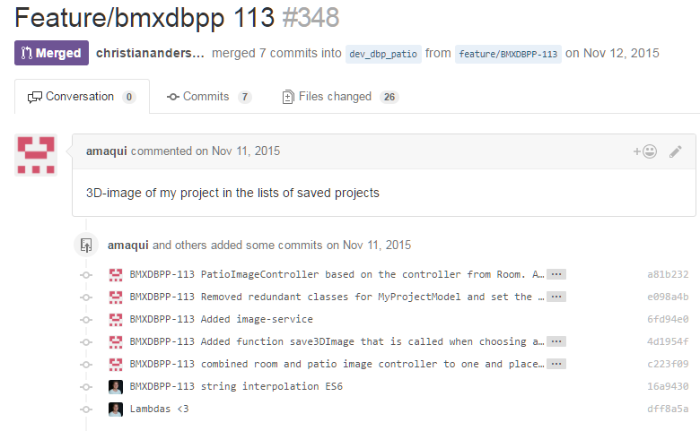
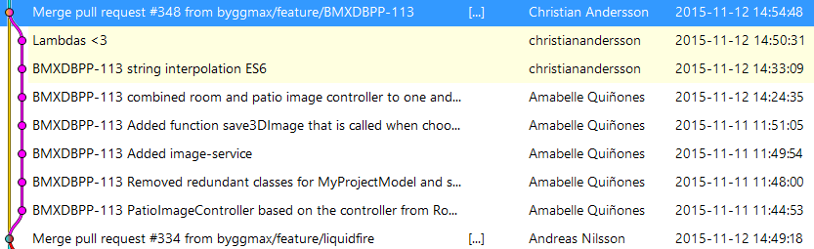
GOAL

Slide 3
Commits
Messages
Imperative mood
Avoid "and" in the subject
Making the most of the subject
Commit early and often
Post-production of commit
Notes:
”The Avensia way of working”

Slide 4
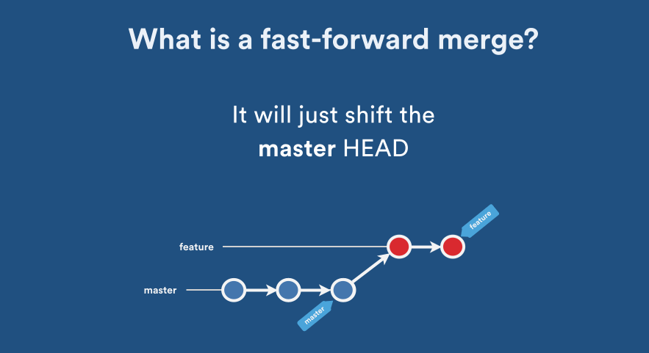
FAST FORWARD MERGE
Notes:
”The Avensia way of working”

Slide 5
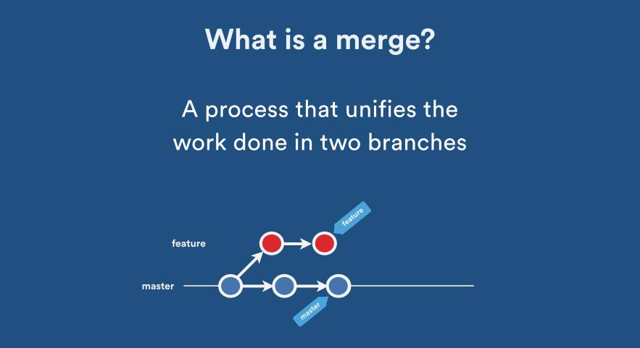
MERGE (no FF)
Notes:
”The Avensia way of working”

Slide 6
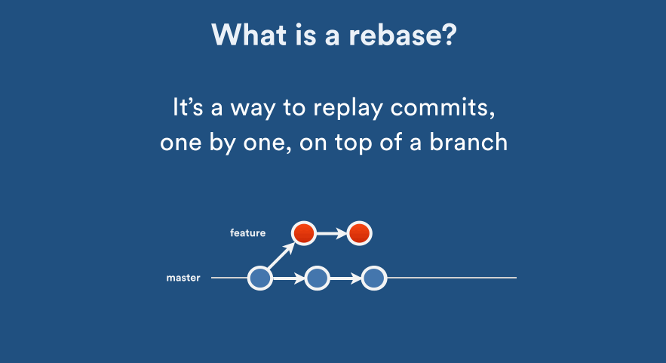
rebase
Notes:
”The Avensia way of working”

Slide 7
Interactive Rebase
git rebase <branch|commit hash> -i
git rebase -i head~<number of commits>
Commands:
p, pick = use commit
r, reword = use commit, but edit the commit message
e, edit = use commit, but stop for amending
s, squash = use commit, but meld into previous commit
f, fixup = like "squash", but discard this commit's log message
x, exec = run command (the rest of the line) using shell
These lines can be re-ordered; they are executed from top to bottom.
If you remove a line here THAT COMMIT WILL BE LOST.
However, if you remove everything, the rebase will be aborted.
Note that empty commits are commented out
Notes:
”The Avensia way of working”

Slide 8

GIT flow A SUCCESSFUL branching strategy
Suggested workflow for features
Checkout dev branch
Pull latest changes
Create feature branch
Commit often
Rebase on dev if dev changes
Post-production of commits
Create Pull Request
Review Pull Request
Fix issues
(Post-production of commits)
(Review)
Merge Pull Request
Notes:
”The Avensia way of working”

Slide 9
GIT flow A SUCCESSFUL branching strategy
Suggested workflow for releases
Checkout dev branch
Pull latest changes
Create release branch
Publish release branch to test
Perform acceptance testing
Publish release branch to prod
Merge release branch to dev
Merge release branch to master
Create tag on master branch
Notes:
”The Avensia way of working”

Slide 10
GIT flow A SUCCESSFUL branching strategy
Suggested workflow for hotfixes
Checkout master branch
Pull latest changes
Create hotfix branch
Implement hotfix
Publish hotfix branch to test
Perform acceptance testing
Publish hotfix branch to prod
Merge hotfix branch to dev
Merge hotfix branch to master
Create tag on master branch
Notes:
”The Avensia way of working”

Slide 11
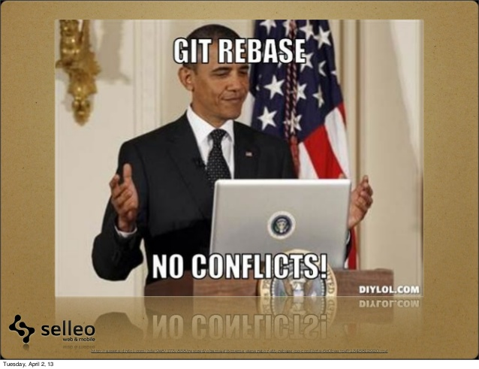

Slide 12
ExerCISE
git clone git@github.com:avensia/gitworkshop.git
Rebase
Merge
Cherry-pick
Pull - -rebase
Interactive rebase
Squash several commits into one
Fix a spelling error by amending the last commit
Enhance the git log by Rewording one commit
Without any conflict
With resolving of conflict
Merge Release branch to dev and master
Pull Request
Create personal feature branch, dev branch and Pull Request
Examine the difference of ”pull” and ”pull –rebase” by executing ”bash prepare_branch” while on the specific branch
Use a commit from one branch in another branch
Eliminate merge commits

Slide 13
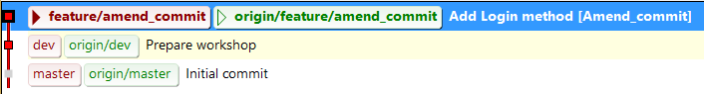
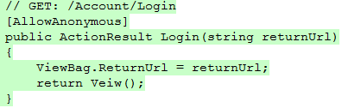
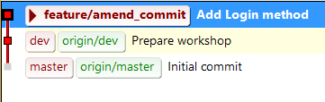
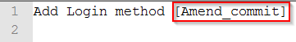
ExerCISE – amend commit
Checkout feature/amend_commit
Fix erroneous code
Edit commit message, save, exit
$ git commit --amend

Slide 14
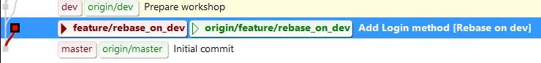
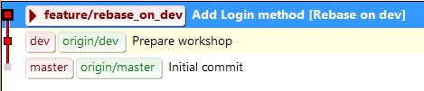
ExerCISE – rebase on dev
Checkout feature/rebase_on_dev
$ git rebase dev

Slide 15
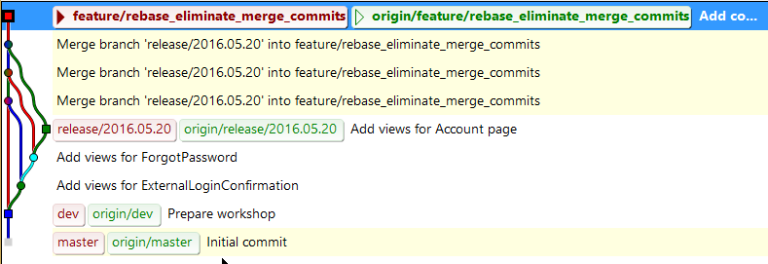
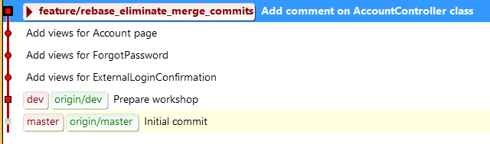
ExerCISE – rebase, eliminate merges
Checkout feature/rebase_eliminate_merge_commits
$ git rebase dev

Slide 16
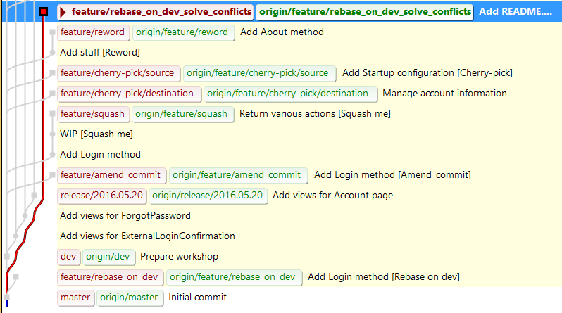
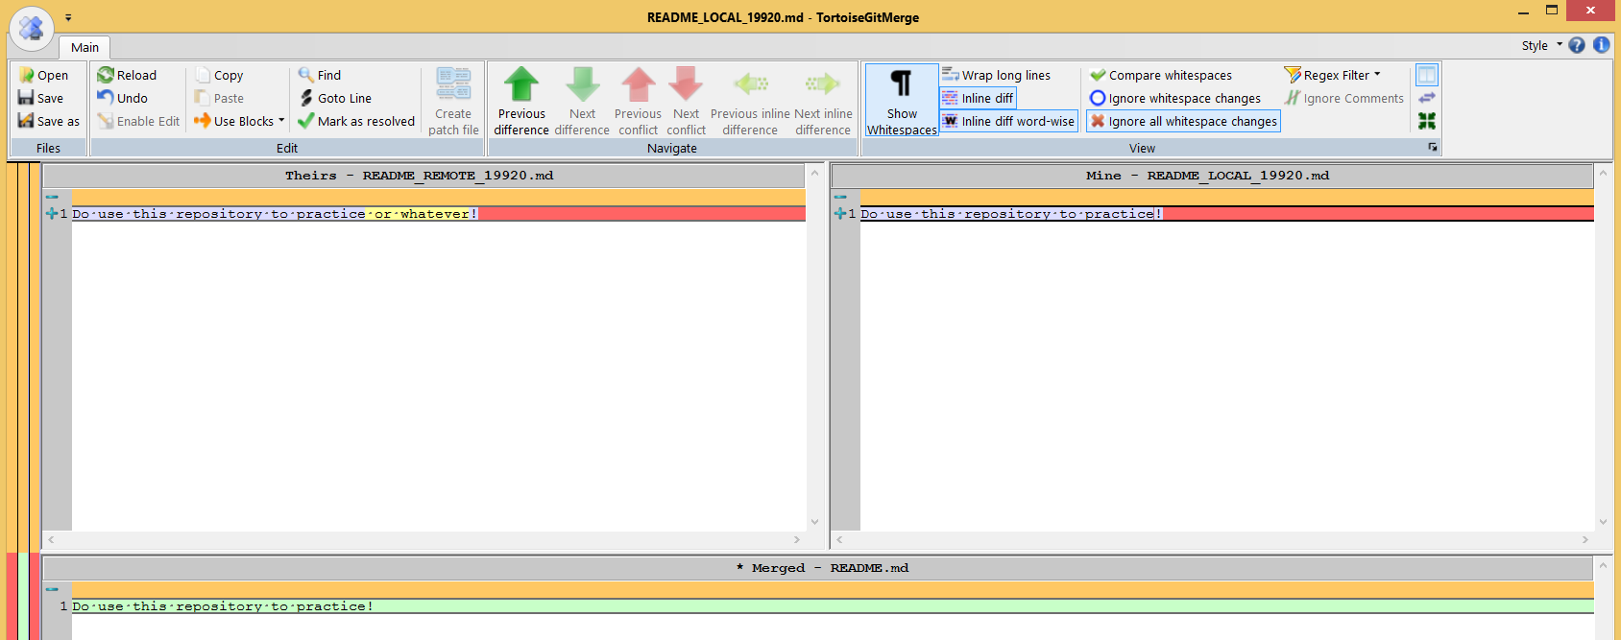
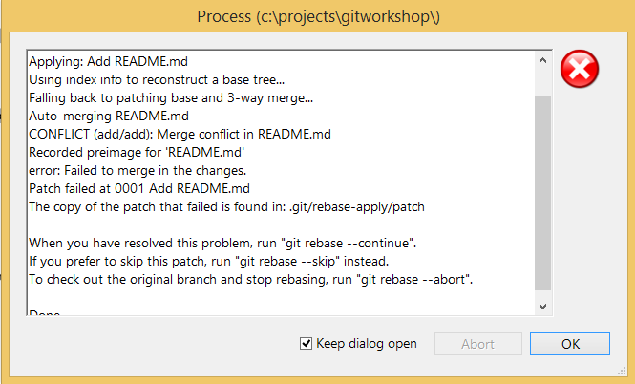
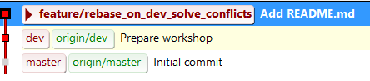
ExerCISE – solve merge conflicts
Checkout feature/rebase_on_dev_solve_conflicts
Solve merge conflict
$ git add .
$ git rebase dev
$ git rebase --continue

Slide 17
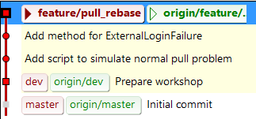
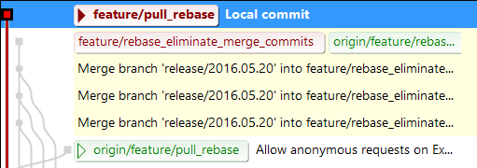
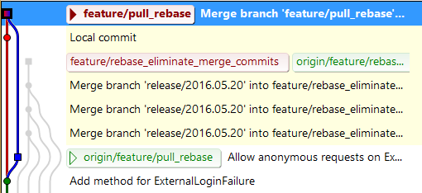
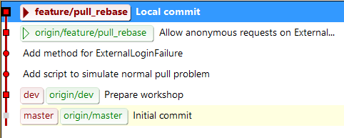
ExerCISE – Test Pull --rebase
Checkout feature/pull_rebase
$ bash prepare_branch.cmd
$ git pull
$ git reset origin/feature/pull_rebase
$ bash prepare_branch.cmd
$ git pull --rebase

Slide 18
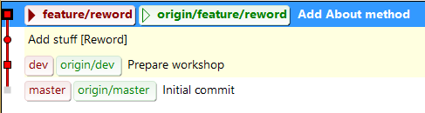
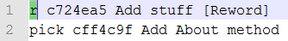
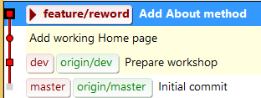
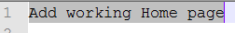
ExerCISE – interactive rebase / reword
Checkout feature/reword
$ git rebase -i head~2
Change ”pick” to ”r” or ”reword” for bad commit message – Save/exit
Compose a better commit message – save/exit

Slide 19
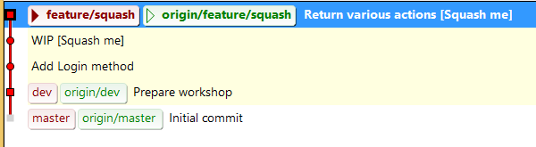
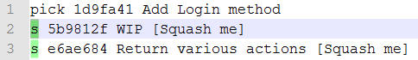
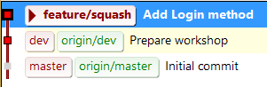
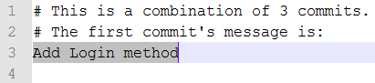
ExerCISE – interactive rebase / squash
Checkout feature/squash
$ git rebase -i head~3
Change ”pick” to ”s” or ”squash” for desired commits – Save/exit
Compose a commit message for the new squashed commit– save/exit

Slide 20
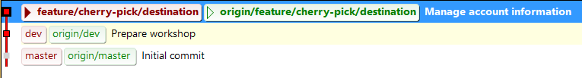
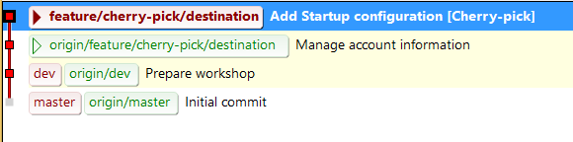
ExerCISE – cherry pick
Checkout feature/cherry-pick/destination
$ git cherry-pick c23d3a296df172a11d1a522c92bf9a7b011a99da

Slide 21
Links
https://confluence.avensia.se/display/DEV/Git
https://sethrobertson.github.io/GitBestPractices/
http://nvie.com/posts/a-successful-git-branching-model/
https://git-scm.com/book/en/v2/Git-Tools-Rewriting-History
Notes:
”The Avensia way of working”

